Slide 1
Developing Apps for Touch and Mobile Devices

Slide 2
Objectives
In this session, you will learn to:
  Plan the UX for a mobile app
  Create wireframes for mobile apps

Slide 3
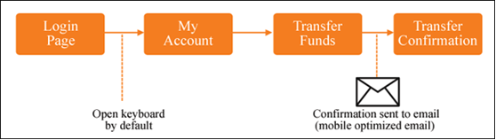
Planning the User Flow
A user flow is a schematic graphical layout of the path that the users will follow to use a mobile app.
As a mobile UX designer, it is essential to design highly effective user flows to make your app useful for the users.
Sample User Flow

Slide 4
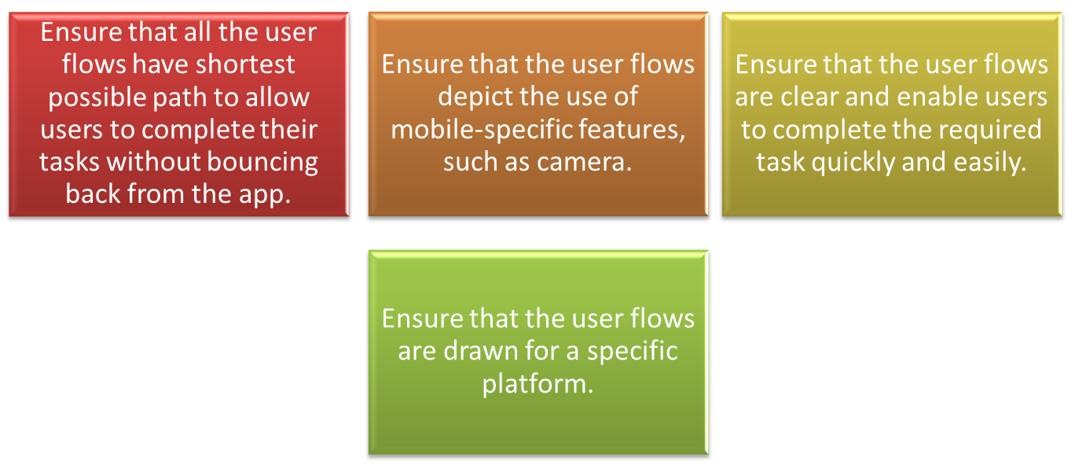
Planning the User Flow (Contd.)
To check the effectiveness of a user flow during the planning phase, use the following guidelines:

Slide 5
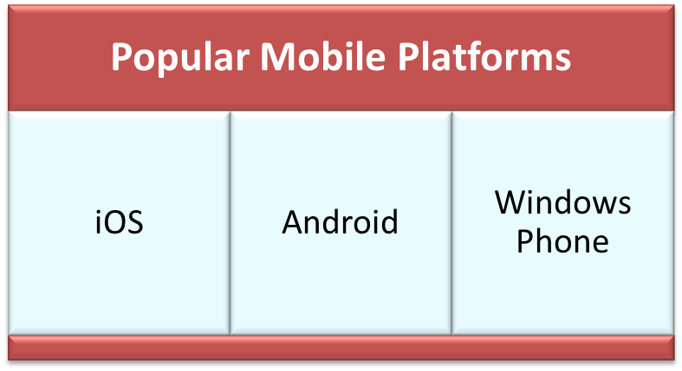
Understanding the Mobile Device
UX designers should know the target device for which the mobile design needs to be created.
UX designers can understand the mobile device that they are targeting by knowing how it works.
UX designers need to be familiar with the various features and services that the device provides.
The only way to understand a device is to get the device and use it to explore its various functionalities.

Slide 6
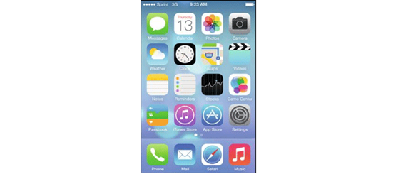

Understanding the Mobile Device (Contd.)
iOS
iOS is an OS developed by Apple, which was earlier known as the iPhone OS.
Home screen is the first screen that iOS mobile device users see once the device is unlocked.
The home screen consists of various icons that are used to launch various apps.
The bottom portion of the screen is used to launch all the primary applications and the phone dialer.
The iOS devices contain a single hardware button known as the home button.
This button is used for multiple purposes, such as displaying the home screen and closing an app.
iOS Home Screen
iOS Home Button

Slide 7
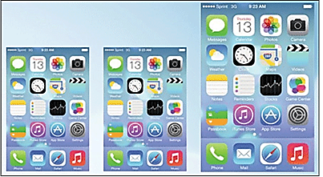
Understanding the Mobile Device (Contd.)
    iOS (Contd.)
    Some of the basic gestures to interact with the iOS devices are:
  Tap
  Double tap
  Drag
  Flick
  Pinch to zoom
The three standard display sizes
for designing the mobile UX
for iOS devices are:
  Standard iOS display for 3.5 inches screen (320x480)
  Retina iOS display for 3.5 inches screen (640x960)
  Retina iOS Display for 4 inches screen (640x1136)
iOS Standard Screen Sizes

Slide 8
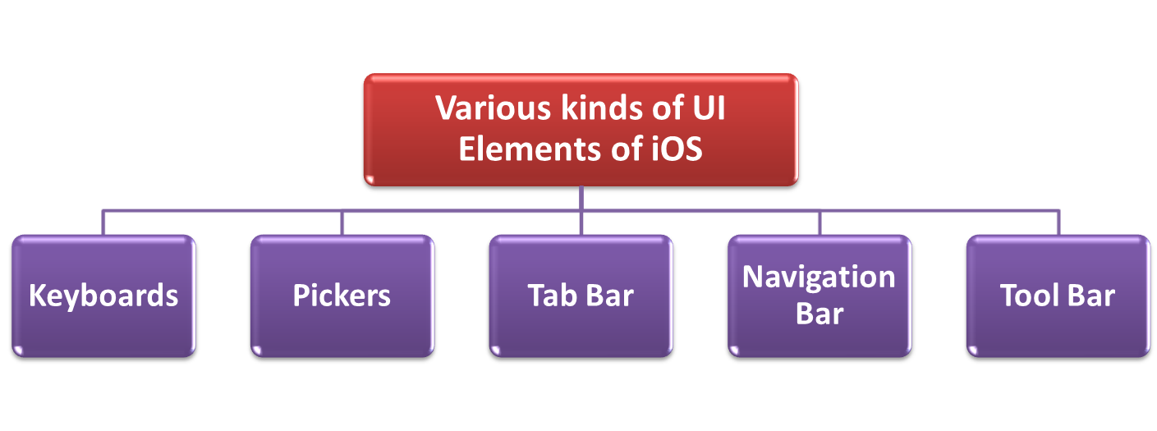
Understanding the Mobile Device (Contd.)
iOS – UI Elements

Slide 9


Understanding the Mobile Device (Contd.)
  iOS – UI Elements (Contd.)
Keyboard of an iOS device always appears at the bottom of the screen.
Pickers are used to:
  Display a scrollable list of options.
  Allow users to select the required option.
Tab bar of iOS devices displays at the bottom of the screen across native apps.
Tab bar consists of various icons that enable users to quickly perform various tasks.
iOS7 Picker
Tab Bar with More Icon
Tab Bar of iOS8

Slide 10


Understanding the Mobile Device (Contd.)
  iOS – UI Elements (Contd.)
Navigation bar always remains fixed at the top of the screen and is used for secondary navigation.
It consists of three areas:
  Left
  Right
  Center
The Tool bar is fixed at the bottom of the screen.
It consists of various icons and buttons related to the current screen and acts as a secondary navigation.
Navigation Bar in an iOS App
Tool Bar of iOS 8

Slide 11
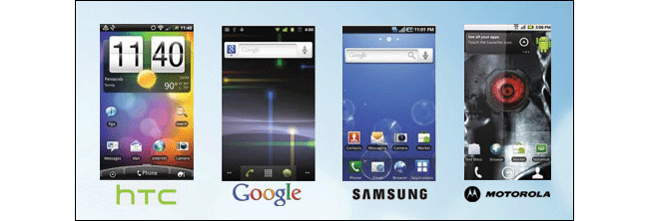
Understanding the Mobile Device (Contd.)
  Android
  Android is an open-source OS developed by Google.
It allows various manufactures of mobile devices as well as individuals to design, build, or install Android on any device.
Being open-source, it enables manufactures to create OS based on their requirements.
Android Operating Systems

Slide 12
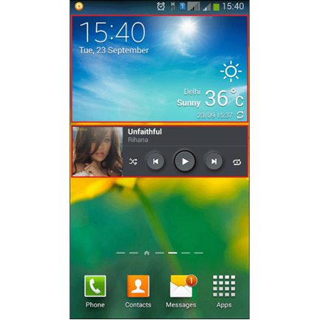
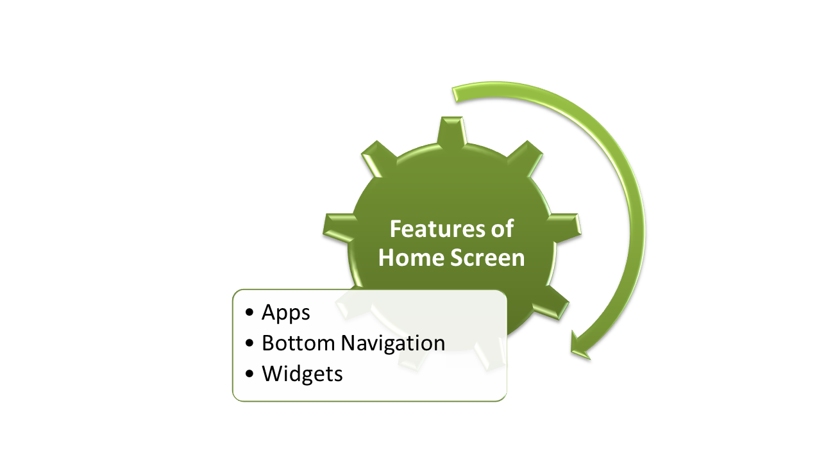
Understanding the Mobile Device (Contd.)
  Android (Contd.)
The home screen of Android devices displays various icons representing apps. These icons are shortcuts to launch apps.
Widgets

Slide 13
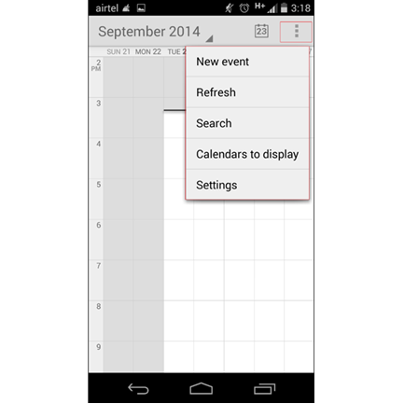
Understanding the Mobile Device (Contd.)
  Android (Contd.)
Android devices contain some hardware buttons that function the same across manufacturers to interact with the devices.
Manufacturers can include some or all of these hardware buttons on their devices based on requirement:
  Back
  Menu
  Search
  Home
  Recent
Action Menu

Slide 14
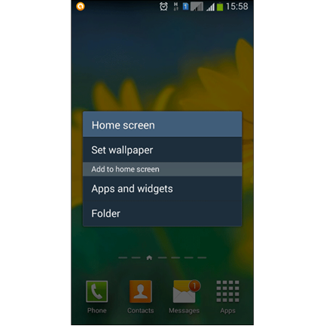
Understanding the Mobile Device (Contd.)
  Android (Contd.)
Like iOS, Android has a unique touch gesture known as 2-second or 2-s touch gesture, it functions similar to the right click of a desktop’s mouse.
The 2-s gesture displays a context menu, popup menu, or navigation options on the screen.
Android devices have a wide range of screen sizes, but the most common screen sizes are 320x480, 480x800, and 540x960.
2-s Gesture Menu

Slide 15
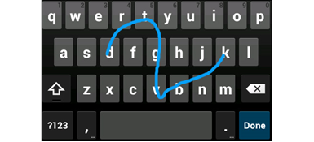

Understanding the Mobile Device (Contd.)
  Android (Contd.)
The keyboard of Android devices appears at the bottom of the screen regardless of its manufacturer.
The design, size, and functionality change from manufacturer to manufacturer.
The Tab bar of Android provides a tabbed navigation to users.
The placement of the Tab bar is not fixed on the screen.
Continuous Input
Android Tab Bar

Slide 16
Understanding the Mobile Device (Contd.)
  Android (Contd.)
The lists in Android consist of a number of options that allow users to select one or more options at a time.
Each list option is known as a list element.
Android elements may be inconsistent across devices of multiple manufacturers.

Slide 17
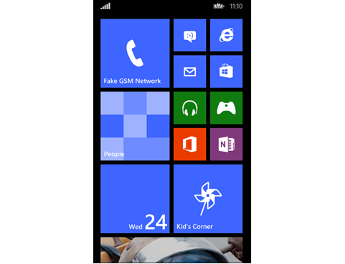
Understanding the Mobile Device (Contd.)
  Windows Phone
Windows Phone is a mobile OS developed by Microsoft.
The home screen of Windows Phone devices displays a grid of tiles.
Each tile represents a specific app.
If the user taps a specific tile, the corresponding app is launched.
Windows Phone devices do not contain a bottom navigation on the home screen.
Home Screen

Slide 18
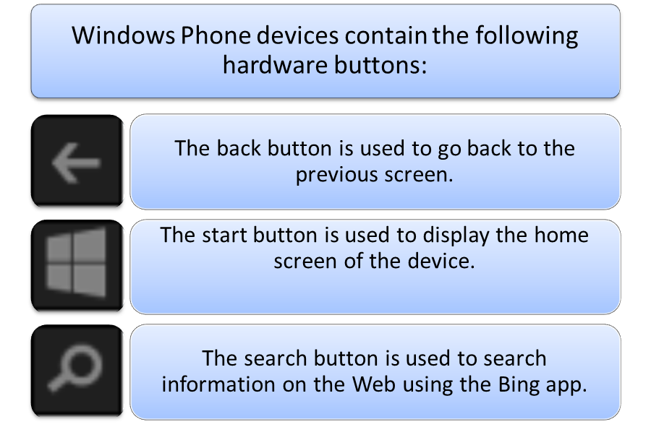
Understanding the Mobile Device (Contd.)
  Windows Phone (Contd.)
Like iOS and Android devices, Windows Phone also contains some hardware buttons that function the same across manufacturers to interact with the devices.

Slide 19
Understanding the Mobile Device (Contd.)
  Windows Phone (Contd.)
The Windows Phone devices support tap, double tap, tap and hold
(2-s gesture), press, press and hold, pan, flick, and pinch gestures.
UI elements of Windows Phone are:
  Keyboards: The types of keyboards supported by HTML5 for Windows Phone are text, e-mail, URL, and number.
  Pickers: Like Android, the pickers that can be included in Windows Phone devices using HTML5 are date, time, date and time, and month.
  Tab bar: The Tab bar of Windows Phone devices displays at the bottom of the screen across native apps. The Tab bar in Window Phone is known as the App bar.
Tab Bar of Windows Phone

Slide 20
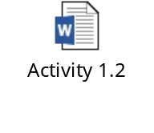
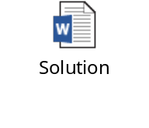
Activity 1.2: Planning the Mobile UX
Problem Statement:
Solution:

Slide 21

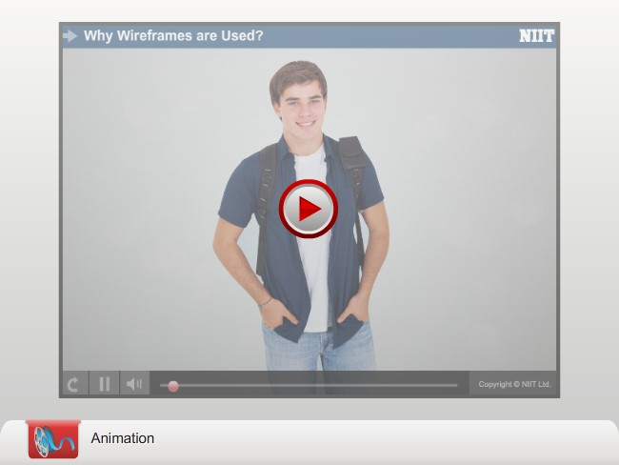
Introduction to Wireframing

Slide 22
Introduction to Wireframing (Contd.)
Wireframes represent the skeletal structure of an app.
Wireframes help in creation of the structure, hierarchy, and relationship between the various elements that collectively form the mobile app.
The process of creating wireframes is known as wireframing.
The main aim of creating a wireframe is to plan the layout and interaction of an app.
During the creation of the layout, you define the size, background, and interface of the experience.
The wireframes are not limited to defining the preceding parameters.
Wireframes can be created manually on paper and can also be created using various online tools, such as Proto, Moqups, UXPin, Balsamiq, and Justinmind.

Slide 23
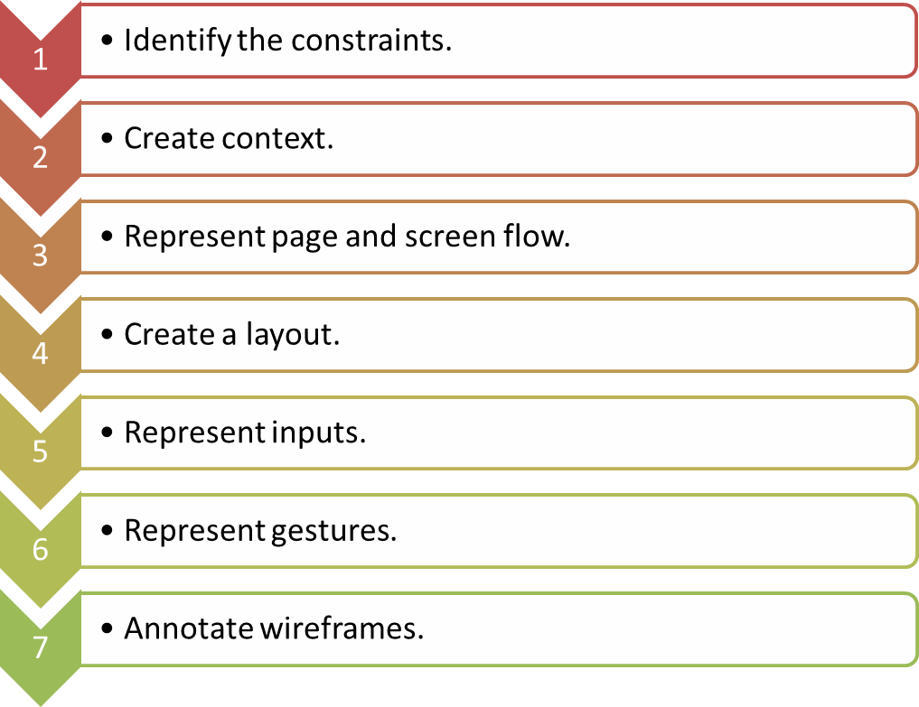
The Wireframing Process
The process of creating wireframes is a step-by-step process that comprises the following steps:

Slide 24
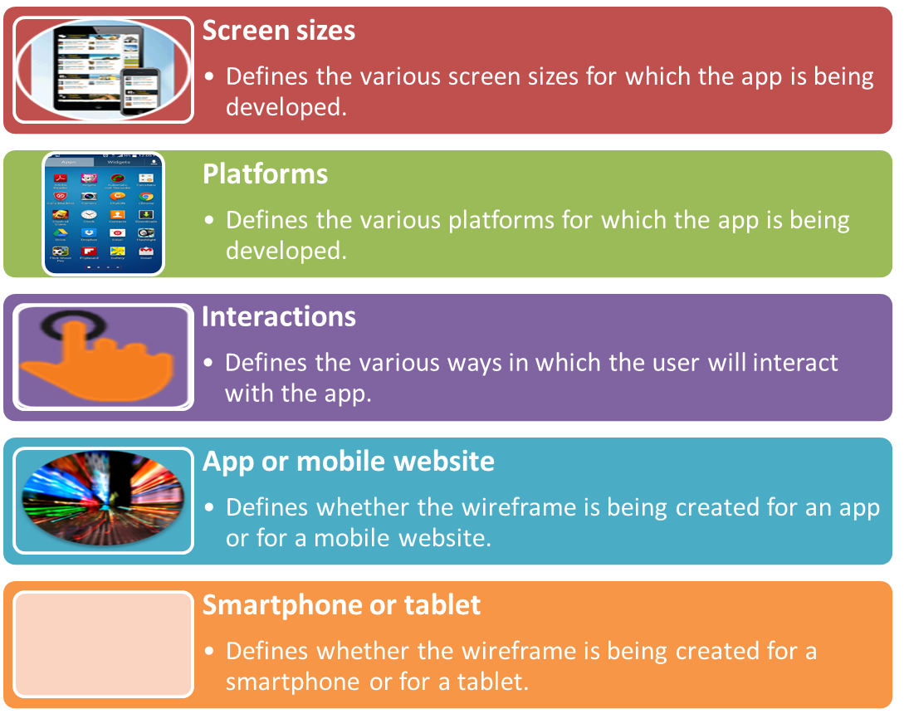
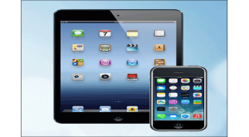
The Wireframing Process (Contd.)
Identifying the Constraints

Slide 25
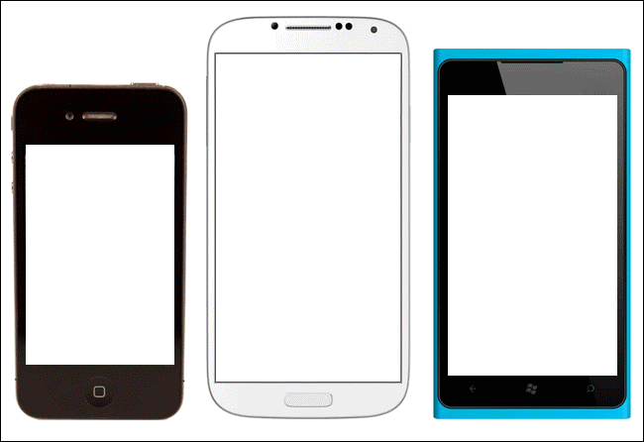
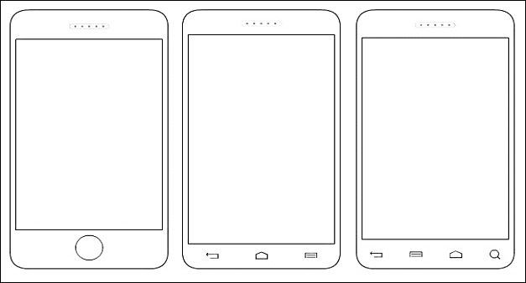
The Wireframing Process (Contd.)
Creating Context
While designing wireframes for an app for various platforms, you need to create separate wireframes for each platform as the look and feel of each platform is different.
Setting a context to the app you are developing helps in:
  Improving visualization.
  Improving contextualization of the experience with respect to the device.
  Handling situations where you need to refer to the hardware buttons.
You can design a wireframe for a specific platform by using the outline image of that particular platform.
Images of Different Devices
Outline of Different Mobile Platforms

Slide 26
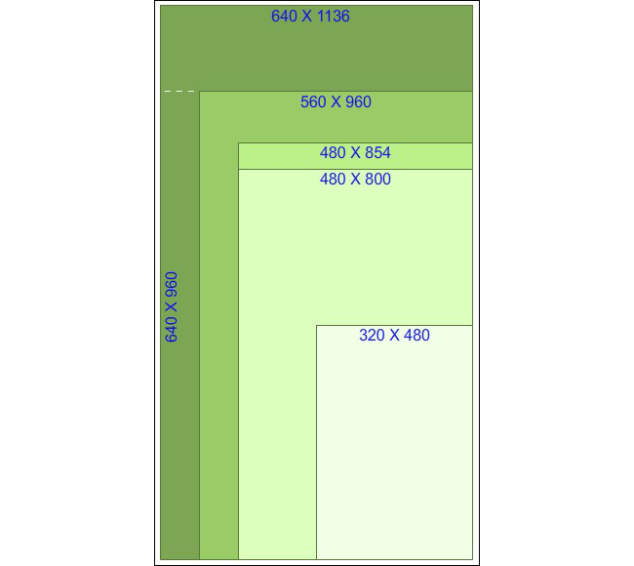
The Wireframing Process (Contd.)
Creating Context (Contd.)
After selecting the appropriate frame, you need to decide the size of the screen for creating the wireframe.
For multiple screen sizes, select a common resolution such as 480×800 pixels.
While selecting a screen size, consider the proportion of the screen’s width to height.
The proportion/size matrix indicates how screen size and proportion change for mobile devices.
Once selected a screen size, ensure that your device image/outline matches the chosen screen size.
Proportion Matrix and
Mobile Screen Size

Slide 27
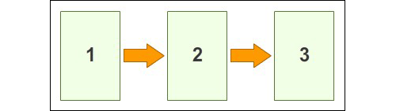
The Wireframing Process (Contd.)
Representing Page and Screen Flows
After selecting the context and the appropriate screen size for your app, you need to represent the user flow.
For this, you need to represent the various pages of the app and their order.
To represent the user flows effectively, you should draw three to four screens together on a single page, with arrows representing the direction of the flow.
Page Representing Screen Flow

Slide 28
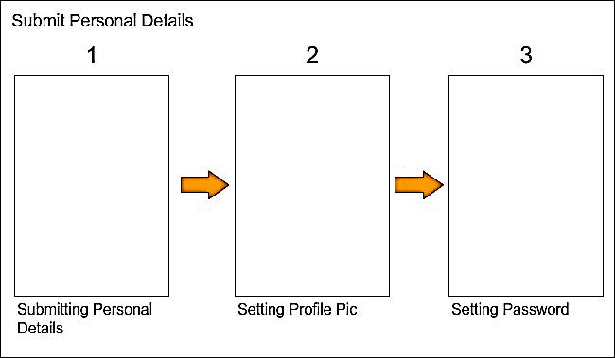
The Wireframing Process (Contd.)
Representing Page and Screen Flows (Contd.)
In case a user flow spans across more than three to four screens, try to break the user flow into two or more user flows.
Example: You have to create a user flow to create a user account on a job portal. As the user flow is very long, you may decide to break down the flow in the following user flows:
  Submit Personal Details
  Submit Academic Details
  Submit Experience Details
Submitting Personal Details

Slide 29
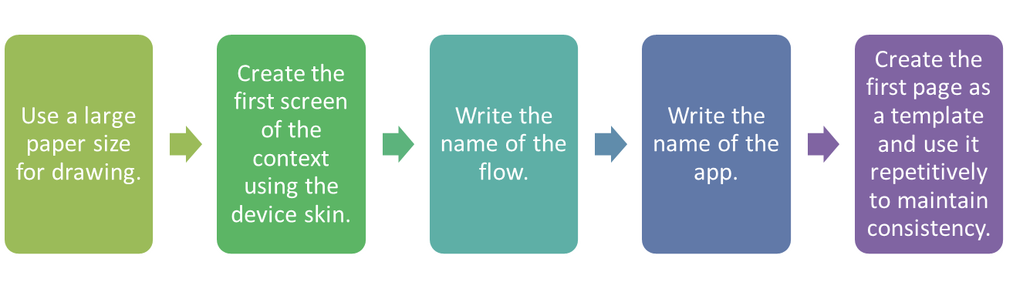
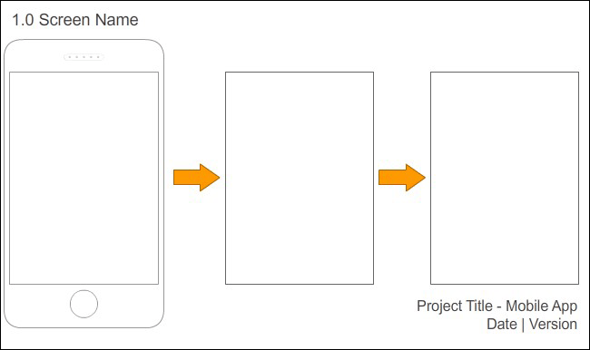
The Wireframing Process (Contd.)
Creating a Layout
Following considerations need to be taken while creating a layout:
Layout with a Device Outline

Slide 30
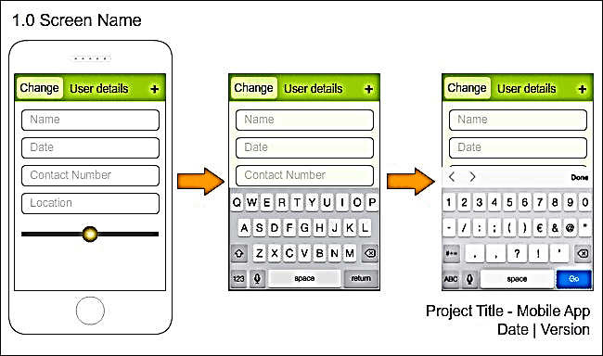
The Wireframing Process (Contd.)
Representing Inputs
While designing a wireframe, you need to consider:
  The device and platform
  Keyboard type and size
  Other standard controls of the UI library
For the convenience of the designers, UI elements are provided by the various platforms in the form of stencils that can be used easily.
Layout With iOS UI Elements

Slide 31
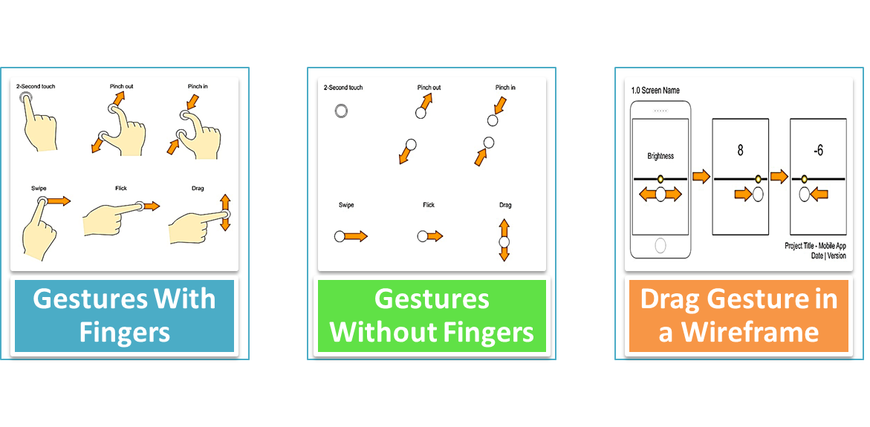
The Wireframing Process (Contd.)
Representing Gestures
While designing a wireframe, you need to design an interaction that requires the representation of a touch gesture.
You can add indicators to represent gestures to the wireframes of the app.

Slide 32
The Wireframing Process (Contd.)
Annotating Wireframes
Annotating Wireframes ensures that every action or interaction that you want to capture is explained with the help of additional notes.
If you want to open a keyboard when the app is launched, you should annotate this information on the first screen.
You should also annotate the available gestures for the UI elements on a screen.
If you are unable to annotate the required information on the screen pages, you can use extra sheets for annotation.

Slide 33

Just a Minute
Which one of the following activities is the first step of creating a wireframe?
Represent page and screen flow
Create a layout
Identify the constraints
Represent inputs
Answer:
Identify the constraints

Slide 34
Summary
In this session, I learned that:

